Slide 2
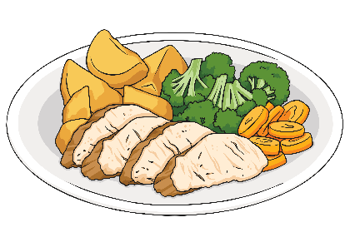
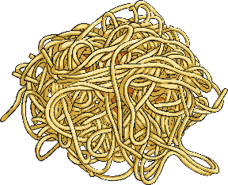
Creating Relative Clause Sentences
We can add extra additional detail about a noun by adding a relative clause to a sentence.
Instead of using two single-clause (simple sentences) to describe something,
e.g. Sarah is eating roast chicken. It is her favourite meal.
We can combine the two sentences to make one multi-clause (complex) sentence using subordination with a relative clause.
e.g. Sarah is eating spaghetti, which is her favourite meal.
A relative clause is connected to the main clause by a relative pronoun. We’ve replaced the pronoun ‘It’ in the second sentence with the relative pronoun ‘which’.

Slide 3
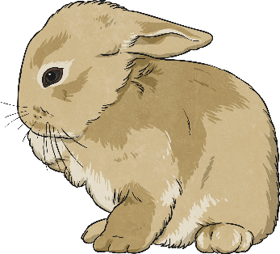
Relative Pronouns
A relative clause always starts with a relative pronoun.
Examples of relative pronouns are:
Can you identify the relative pronouns in these sentences?
We went to the new swimming pool, which has three fantastic slides.
Josie, who loves to play football, was picked for the county team.
Sadiq, whose pen had run out, put his hand up to ask for another one.
The boy whom you met last week is coming to visit later.
My Grandad caught the rabbit that had escaped.
whose
which
who
that
whom

Slide 4
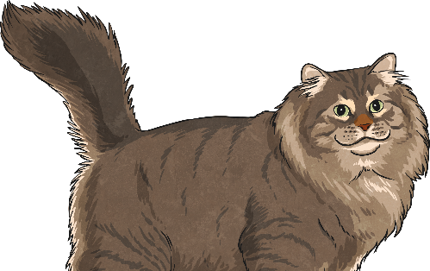
Where Can a Relative Clause Be Placed?
Where in these sentences are the relative clauses placed? How do you know?
The class were well-behaved on the school trip, which made their teacher proud.
William, who was wearing his favourite shirt, was going to the school disco.
I go to a swimming club early in the morning, which means that I’m tired by the afternoon.
Have you seen the people whom we met yesterday at the park?
Amir found the missing cat that his neighbour had lost.
Relative clauses can be in the middle of a sentence (embedded) or at the end of a sentence.

Slide 5
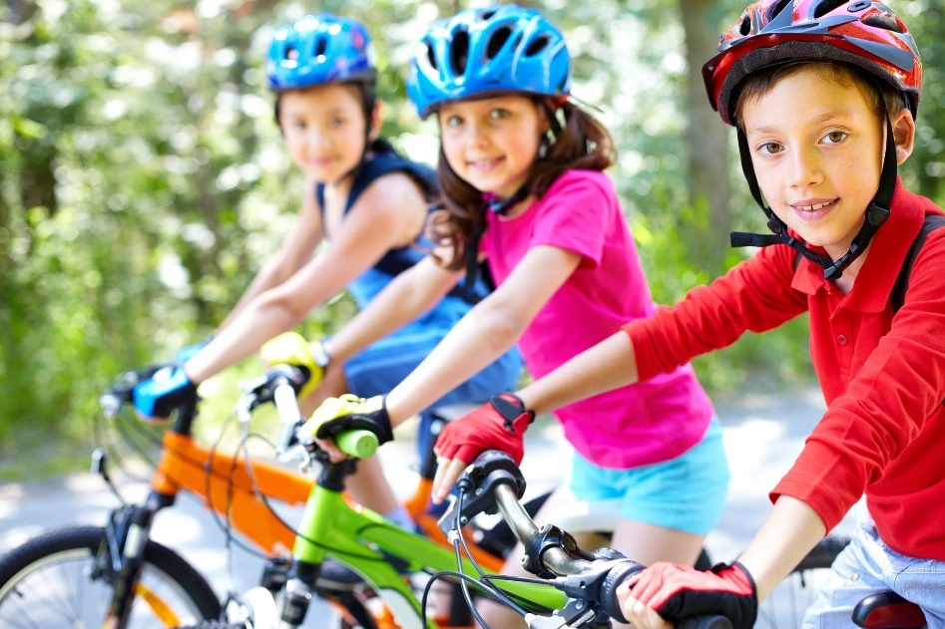
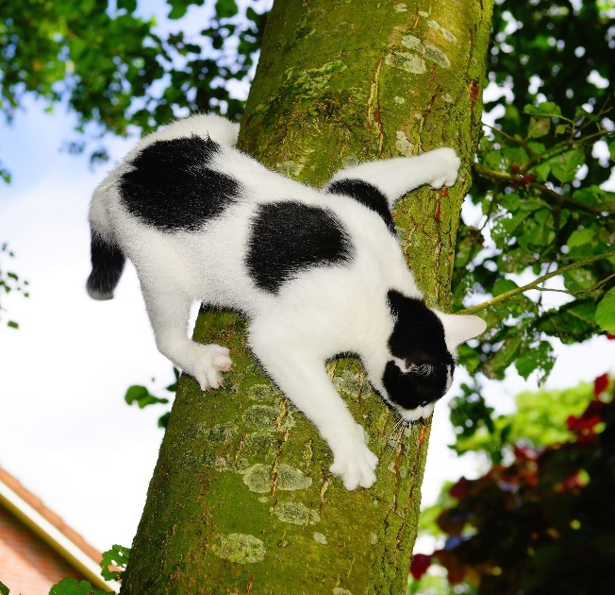
Creating Relative Clauses
Write sentences about the following pictures and include an embedded relative clause:
My cat, which was black and white, got stuck up a tree.
The children, who all wore helmets, were excited about their cycling trip.

Slide 6
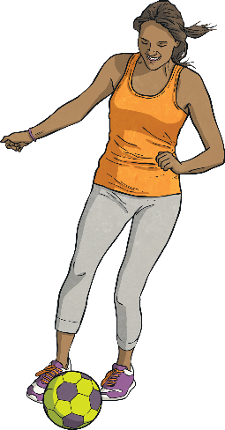
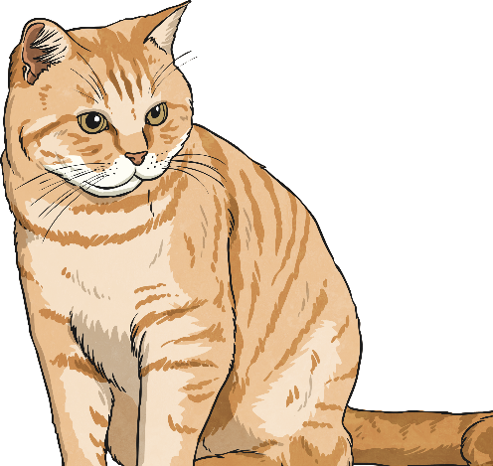
Is the Information Essential?
Josie, who loves to play football, was picked for the county team.
The information given in this relative clause is extra, non-essential (or non-restrictive) information which means that we use commas around the relative clause.
Amir found the missing cat that his neighbour had lost.
In this sentence the relative clause contains essential (or restrictive) information so the commas have been omitted – there might be lots of cats but this was the missing cat that belonged to Amir’s neighbour.

Slide 7
Is the Information Essential?
Decide whether these relative clauses are restrictive or non-restrictive.
Add commas where you need them:
Jamie who is usually late managed to arrive on time for school today.
We went to the best adventure playground which had a huge climbing wall while we were on holiday last week.
The children did well in the dance show which made their teacher happy.
,
,
non-restrictive.
,
,
non-restrictive.
,
non-restrictive.

Slide 8
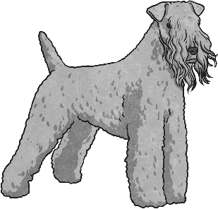
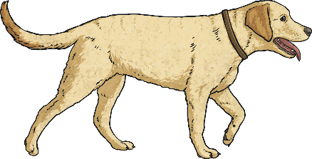

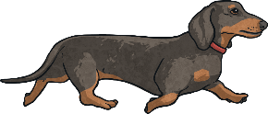
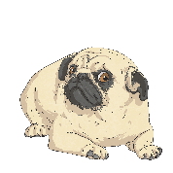
Is the Information Essential?
Decide whether these relative clauses are restrictive or non-restrictive.
Add commas where you need them:
The prize that I won was a very special signed book.
Mia whose favourite colour is orange was unhappy to be in the green team for Sports’ Day.
Those are the dogs that ran on the grass.
restrictive.
,
,
non-restrictive.
restrictive.

Slide 9

Do I Need a Relative Pronoun?
In a restrictive relative clause it is possible to omit the relative pronoun if it refers to the object of the sentence:
e.g. Amir found the missing cat that his neighbour had lost.
Could be written as:
Amir found the missing cat his neighbour had lost.
Read the following sentences containing restrictive relative clauses and decide whether it is possible to omit the relative pronoun:
The test that we did yesterday was really easy.
The class that had the most points was given extra play.
The book that I bought yesterday cost me three pounds.

Slide 10
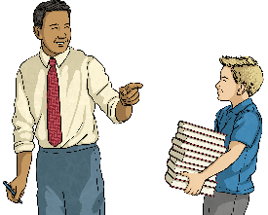
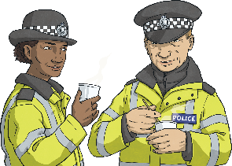
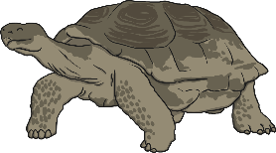
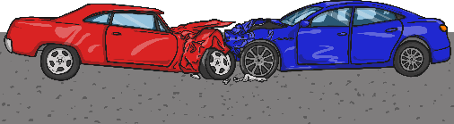
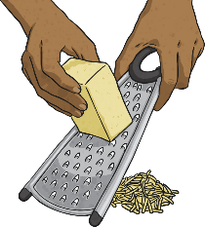
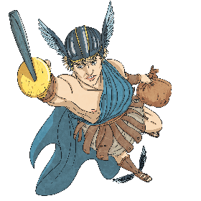
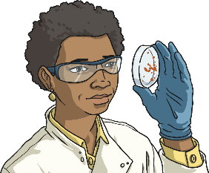
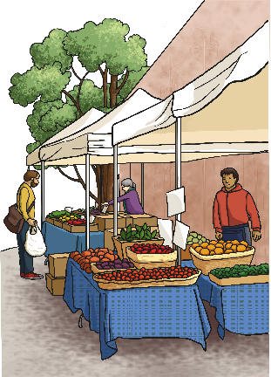
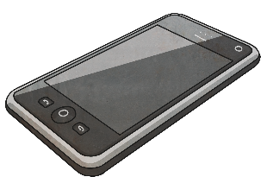
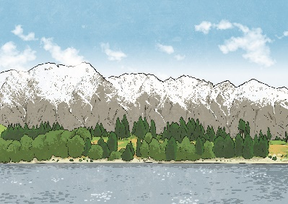
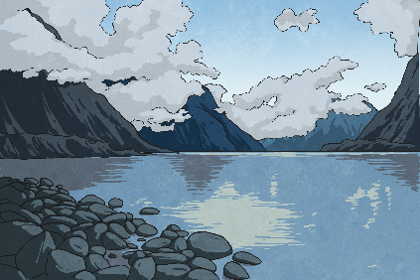
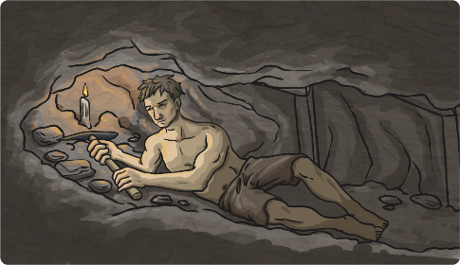
Writing Relative Clause Sentences
Choose a square to reveal a hidden picture. Write a relative clause sentence about the picture on your whiteboard. Underline your relative pronoun.
?
?
?
?
?
?
?
?
?
?
?
?
next

Slide 11
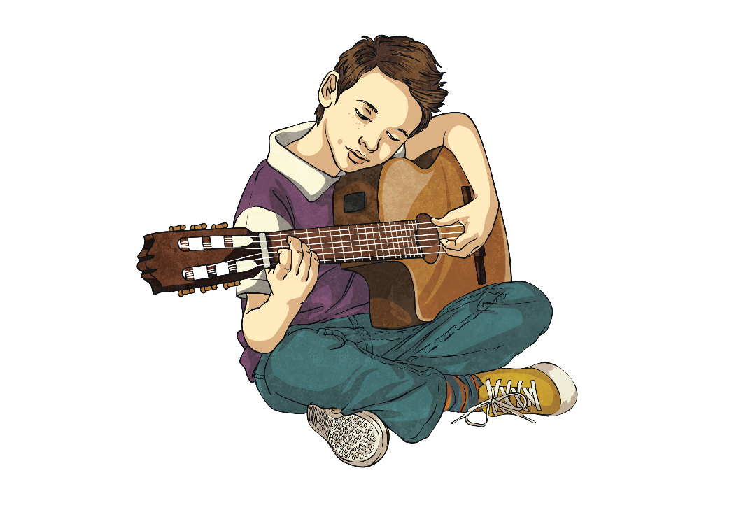
Quick Quiz 1
For each sentence, identify the relative pronoun:
I can’t eat that chocolate bar because it has nuts in, which I’m allergic to.
Mangoes, which are grown in tropical countries, are one of my favourite foods.
The cats that were caterwauling last night kept me awake.
Jamal, who is a fantastic guitarist, has joined the school band.

Slide 12
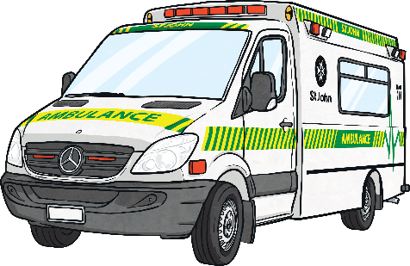
Quick Quiz 2
Can you match the main clause to the appropriate relative clause?
The cat scratched my arm,
The paddling pool is full of cool water,
I have a sister,
The ambulance rushed to help the child,
who is three years younger than me.
who had fallen from the tall slide.
which made it sore.
which is fabulous on this hot day.

Slide 13
Quick Quiz 3
Can you break each relative clause sentence back down into two single-clause (simple) sentences?
I look just like my dad, whose hair is black too.
I look just like my dad. His hair is black too.
My rabbit, who loves carrots, always runs up to me when I go to its hutch.
My rabbit always runs up to me when I go to its hutch. It loves carrots.
Micah, whose legs were aching, finally completed the race.
Micah finally completed the race. His legs were aching.

